Slide 1
Distance Time Graphs

Slide 2
5 questions
Topic: Distance Time Graphs
EQ: How can we use distance time graphs?
1. If your average speed is 40km/h, how long does it take to travel 50km?
2. 5060cm = _______m
3. 0.5 minutes = ______ seconds
4. Share $20 in the ratio 1:4
5. If an distance on a map is 5cm with the scale of 1:50, how far is it in real life?

Slide 3
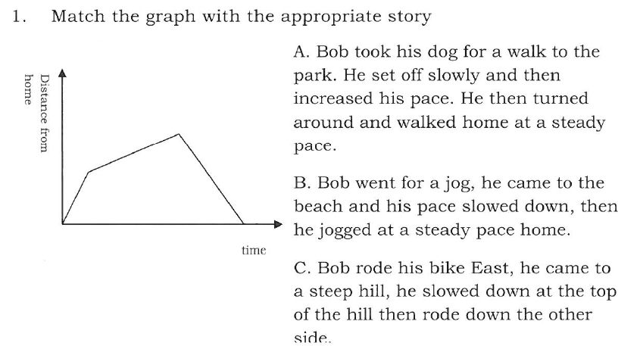
Bob and his travels
THINK PAIR SHARE
Think which story goes with the graph
Pair with your shoulder partner to discuss your answers
Be prepared to share you answer with the class

Slide 4
Topic: Distance Time Graphs
EQ: How can we use distance time graphs?
What is a distance Time graph?
Distance time graphs have time on the x-axis (horizontal) and distance on the y-axis (vertical)
What do different slopes mean?
A horizontal section indicates there is no movement / stationary
A steep line indicates high speed / fast
A gently sloping line indicates a low speed / slow
A straight line indicates constant speed, a change in the slope means there is a change in the speed
Going up means going away, going down means coming back

Slide 5
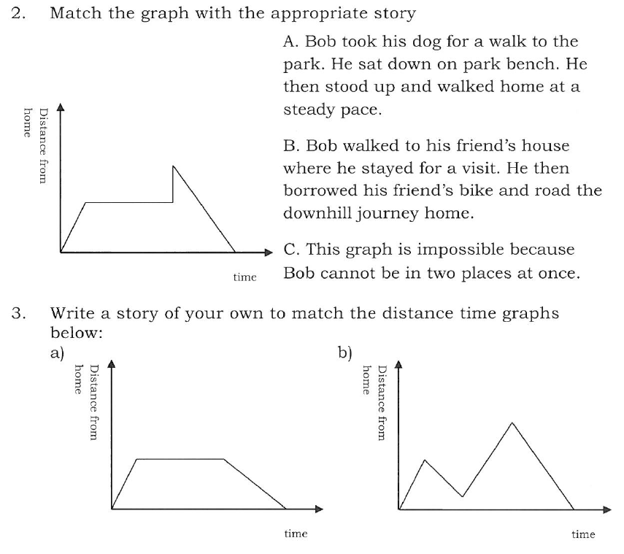
Some questions

Slide 6
Topic: Distance Time Graphs
EQ: How can we use distance time graphs?
Example:
This graph shows a journey taken by a cyclist one day.
Distance from home
(km)
How do we interpret distance time graphs?
Calculate the speed for part A.
10
9
Speed
= distance ÷ time
8
= 4
÷ 20
7
= 0.2 km per minute
6
x by 60
to convert to km per hour
5
0.2 x 60
4
3
A
2
4
1
20
12 km per hour
0
0
10
20
30
40
50
60
70
80
90
100
Time (minutes)

Slide 7
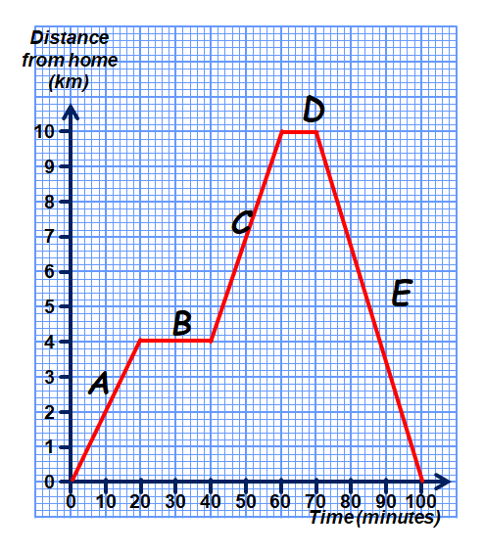
Some more questions
This graph shows the journey of a cyclist one day
At which points is the cyclist stationary?
Calculate the speed of the cyclist in part E
How far does the cyclist ride in total?
How long does the cyclist take to get to part D from the start?

Slide 8
More practice
Page 209 to 211 from the MAWA text book

Slide 9
Exit pass
Write your summary for this lesson.
Topic: Distance Time Graphs
EQ: How can we use distance time graphs?

